Slide 1
Ascii Art Checkpoint 3
Kane, Trevor, Kyle, Cory, Trent

Slide 2


Goal
The goal of our project is to convert images into good looking Ascii Art in an efficient manner
The project deals with algorithms for selecting Ascii Characters, front and back-end development, and GUI design.

Slide 3
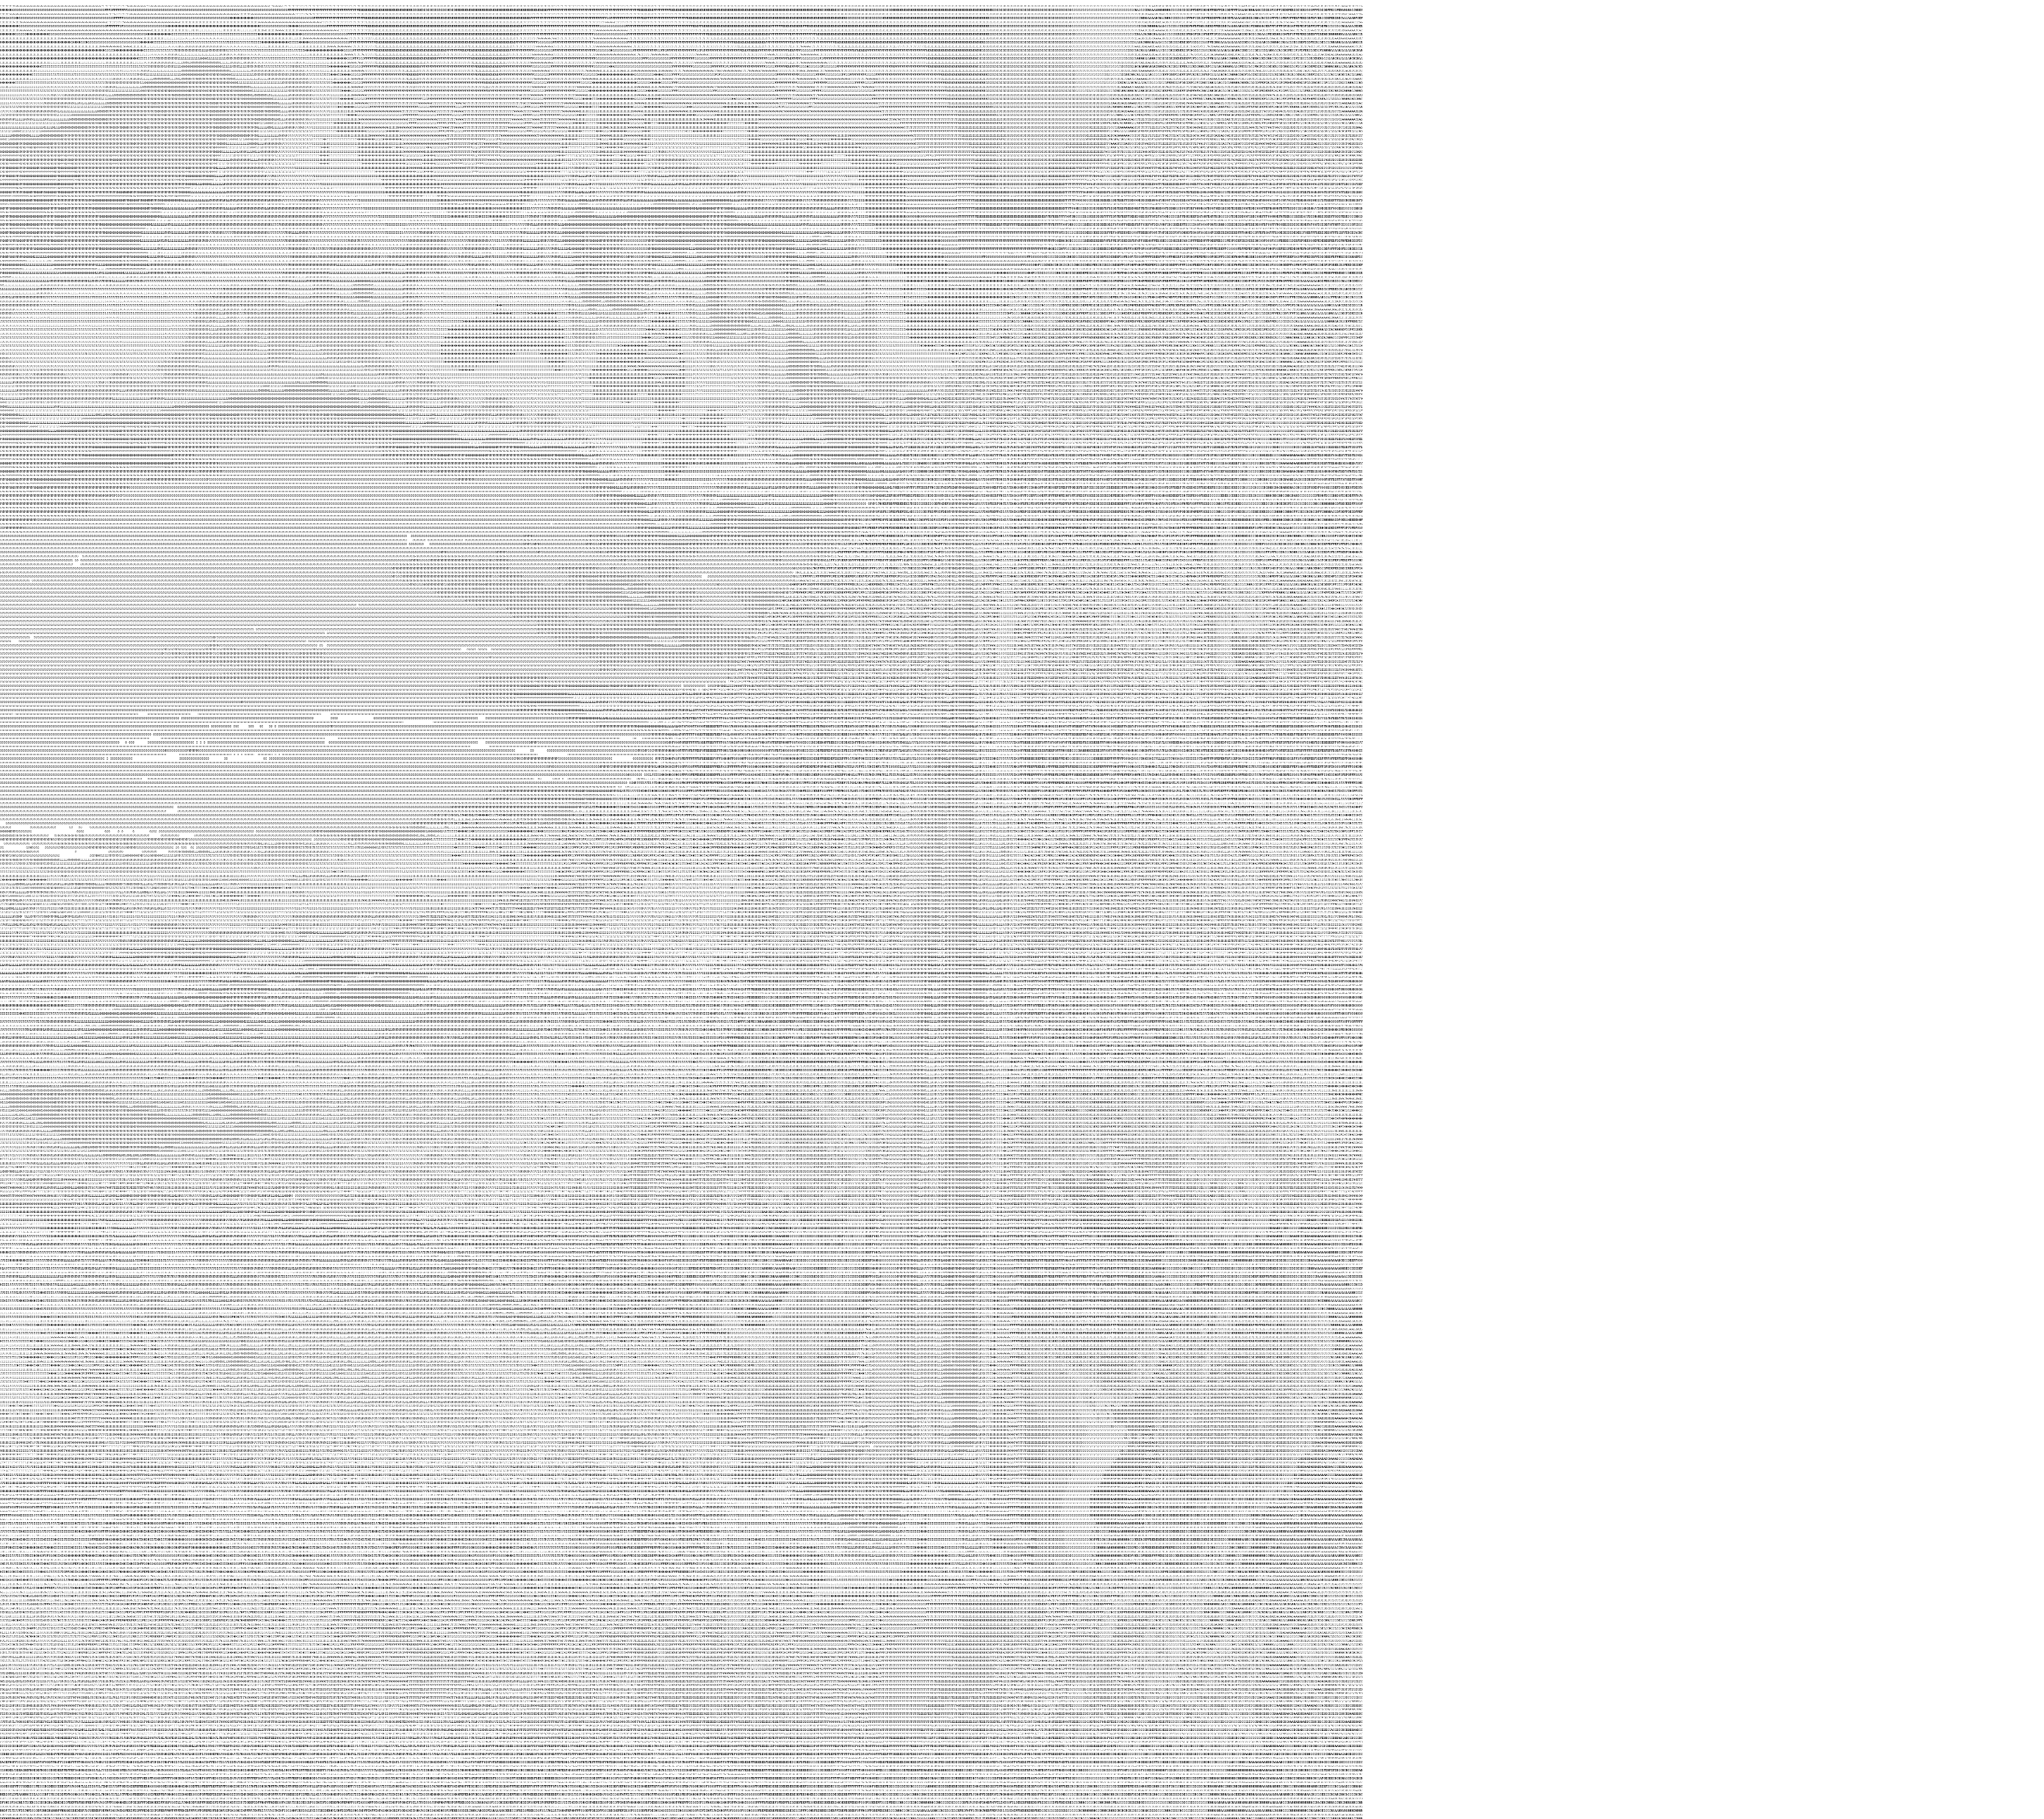
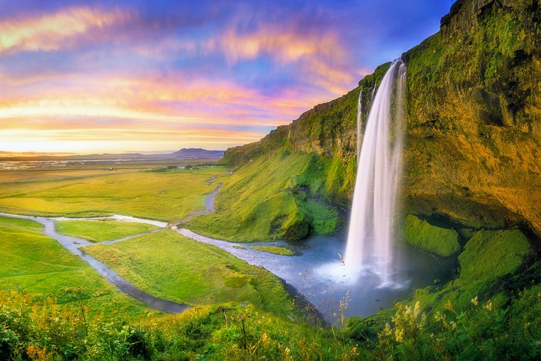
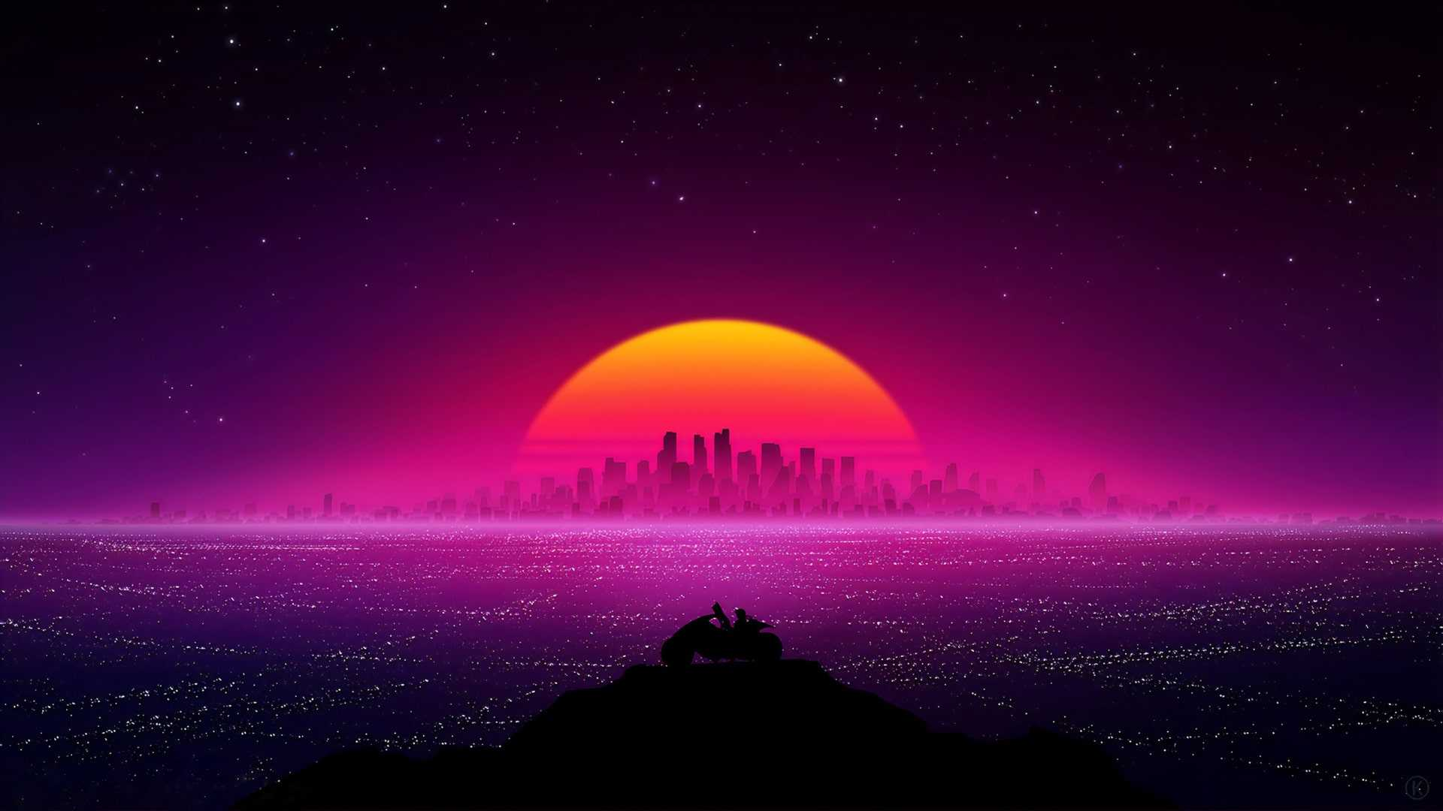
Current Development
Clean GUI for user interaction
Conversion Algorithm that reads pixel in grayscale and converts to an Ascii Character
Built ability to have standalone file instead of cloning from github (executable)
File Manager system

Slide 4
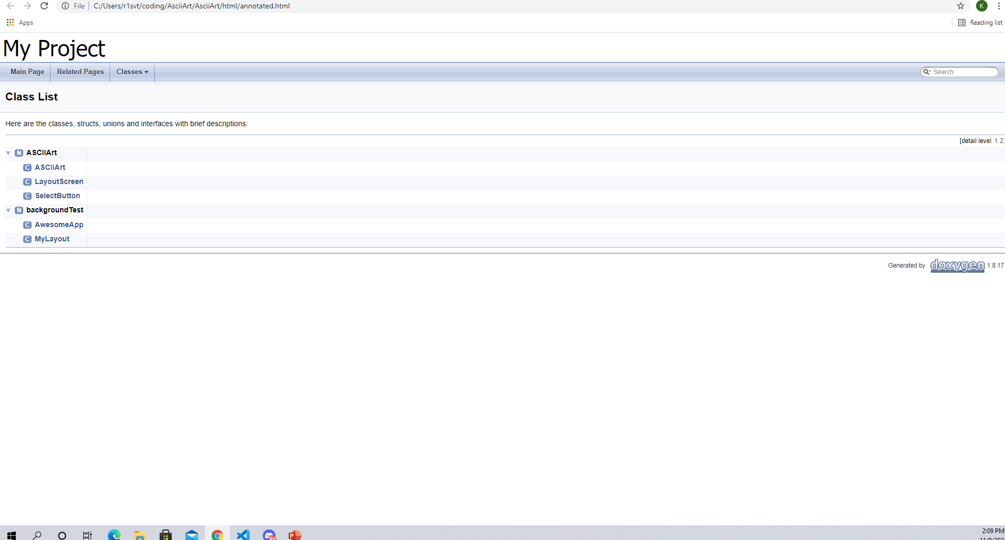
Documentation Tool (Doxygen)

Slide 5
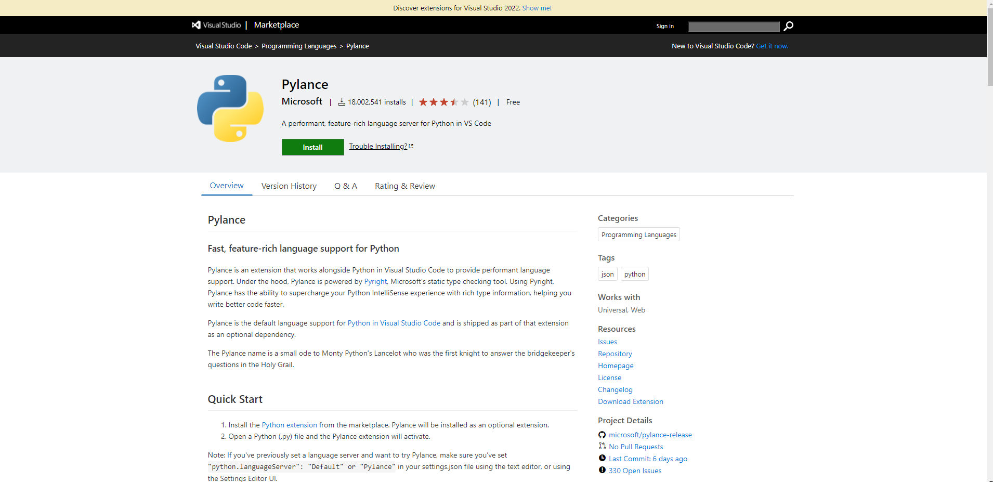
Static Analysis (Pylance)

Slide 6
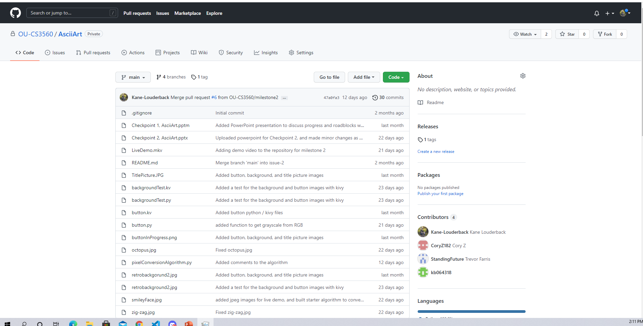
Source Code Management (Git)

Slide 7
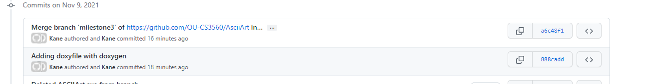
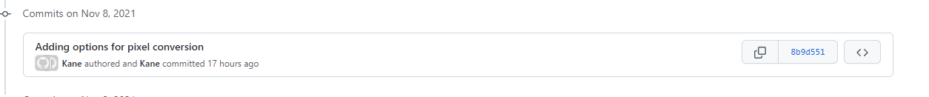
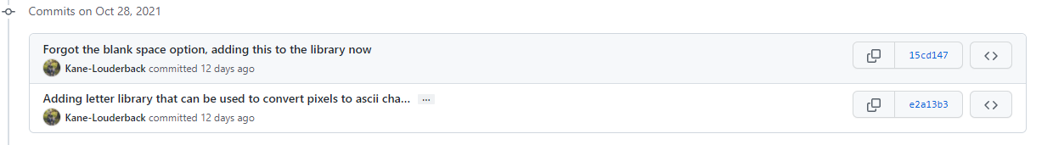
GitHub Walk-Through (Kane)

Slide 8
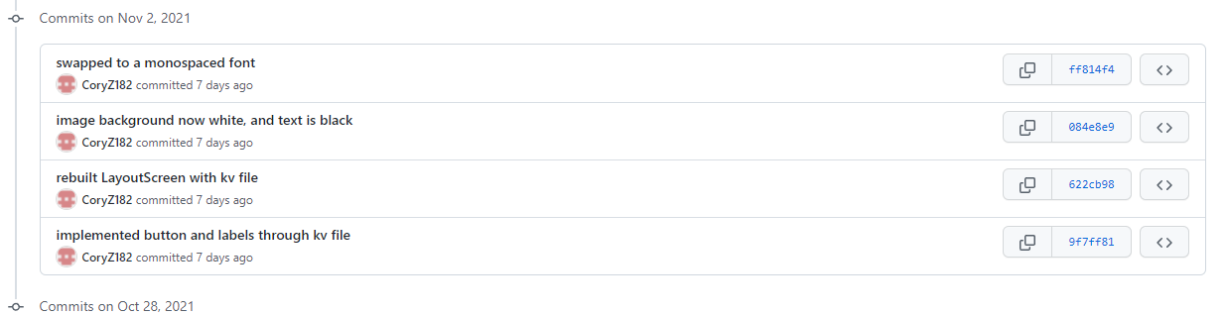
Github Walk Through (Cory)

Slide 9
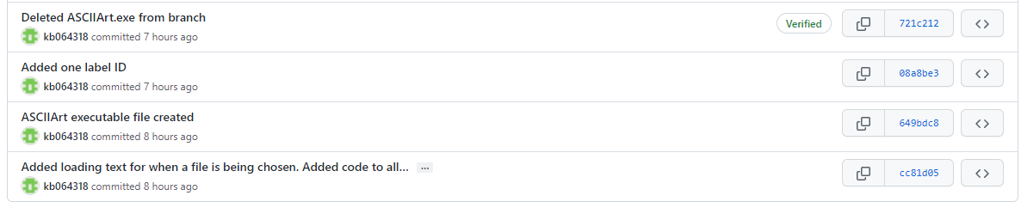
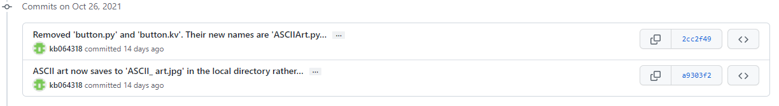
Github Walk Through (Kyle)

Slide 10
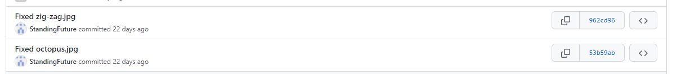
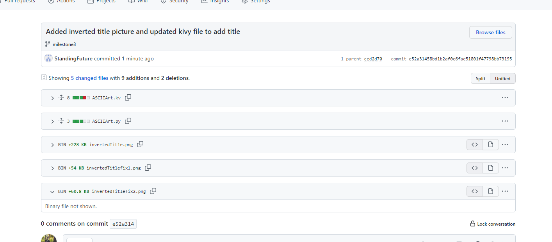
Github Walk Through (Trevor)

Slide 11
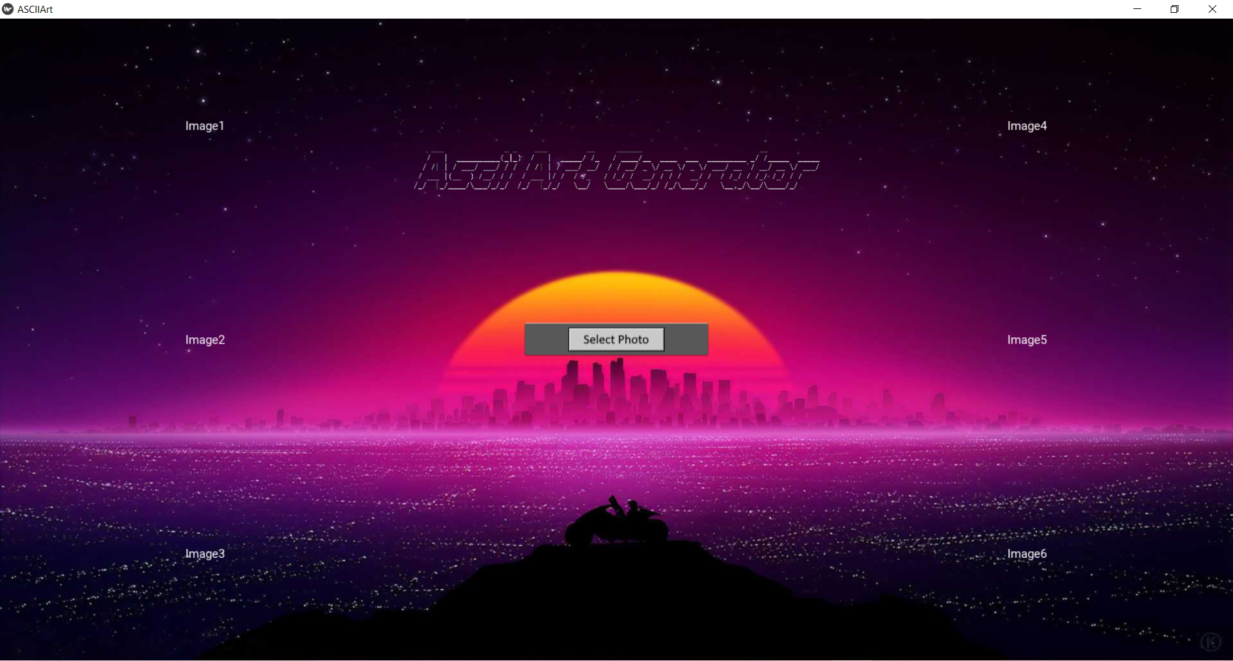
Future Significant Contributions
Further complication of the Pixel Conversion Algorithm
Further Optimize Executable (Mobile Development?)
Fix Outliers in Images
Further Advance and optimize GUI (Add/Enlarge Title)

Slide 12

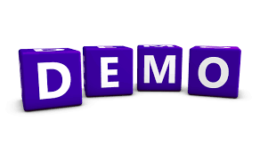
Plan for Final Demo
The plan for the final demo is a live presentation with a video backup just in case. In the final live demo we will go over improvements and other items. All members will be present.
GitHub Repo: https://github.com/OU-CS3560/AsciiArt

